Slide 1
National Parks’ Biodiversity
Data analysis on endangered species – review by Marco Cavalazzi

Slide 2
Data considered
In the National Parks’ Database, we find the following information about each animal.
Category (Mammal, Bird, Reptile, Amphibian, Fish, Vascular Plant, Nonvascular Plant)
Scientific Name
Common Name
Conservation Status (No Intervention, Species of Concern, Endangered, Threatened, In Recovery)

Slide 3
The current situation
Examining the data, we find that:
There are 5824 species in the parks
Between those, the number of endangered species is:
Conservation status | Count
In Recovery | 4
Threatened | 10
Endangered | 16
Species of Concern | 161
No Intervention | 5633

Slide 4
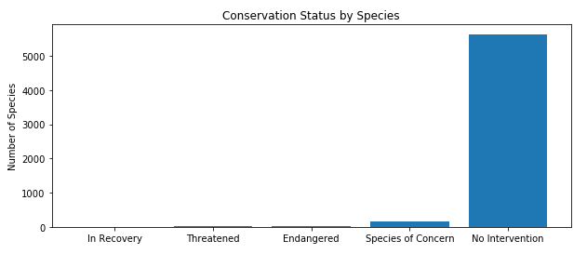
The current situation
The following bar chart gives a graphical explanation of the data collected:

Slide 5
The current situation
The data also show that some categories are more likely to include endangered species.
Category | Not protected | Protected | Percent protected
Amphibian | 73 | 7 | 0.087500
Bird | 442 | 79 | 0.151631
Fish | 116 | 11 | 0.086614
Mammal | 176 | 38 | 0.177570
Nonvascular Plant | 328 | 5 | 0.015015
Reptile | 74 | 5 | 0.063291
Vascular Plant | 4424 | 46 | 0.010291

Slide 6
Our approach
In order to best evaluate the results of our analysis, we decided to study the differences between the groups. Using the Chi Square test we can understand if the numerical differences had statistical significance or were the result of mere coincidence.
A Chi Square (X²) statistic is used to investigate whether distributions of categorical variables differ from one another.
Data Type | Question Type | Possible Responses
Categorical | What is your sex? | male or female
Numerical | Discrete - How many cars do you own? | two or three
Numerical | Continuous - How tall are you? | 72 inches

Slide 7
Findings
Studying the difference between protected mammals and birds we find that the Chi Square test returns a p-value of 0.445901703047, which is way higher than 0.05, so there is no significant difference between the two groups. They both present almost the same percentage of endangered species.
On the other hand, confronting mammals and reptiles we find a p-value of 0.0233846521487. This tells us that there is a significant difference between the groups of animals. In particular, there is a significantly higher percentage of endangered mammals than reptiles.

Slide 8
Findings
Conservationists have been recording sightings of different species at several national parks for the past 7 days. An analysis of the data regarding sheeps tells gives us the following table:
Category | Scientific name | Common names | Conservation status | Is protected | Is sheep
Mammal | Ovis aries | Domestic Sheep, Mouflon, Red Sheep, Sheep (Feral) | No Intervention | False | True
Mammal | Ovis canadensis | Bighorn Sheep, Bighorn Sheep | Species of Concern | True | True
Mammal | Ovis canadensis sierrae | Sierra Nevada Bighorn Sheep | Endangered | True | True

Slide 9
Findings
The number of observations for all three sheeps’ species for each National park is:
Park name | Observations
Bryce National Park | 250
Great Smoky Mountains National Park | 149
Yellowstone National Park | 507
Yosemite National Park | 282

Slide 10
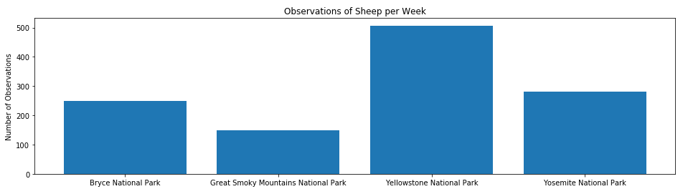
Findings
The equivalent bar chart is:

Slide 11
Problem
Our scientists know that 15% of sheep at Bryce National Park have foot and mouth disease. Park rangers at Yellowstone National Park have been running a program to reduce the rate of foot and mouth disease at that park.
We want to test whether or not this program is working and we want to be able to detect reductions of at least 5 percentage points.

Slide 12
Conclusions
According to the data, the categories at risk, and thus to keep under strict observation, are mammals and birds.
In particular, regarding sheeps we can devise through Optimize the number of sheeps to observe in order to be confident in our results for the foot and mouth desease, which is 510.
According to the data previously shown, in order to have enough data for the Bryce National Park we will need to collect data for 2 weeks (2.04 weeks).
For the Yellowstone National Park, instead, 1 week will suffice (1.005917 weeks).

